Slide 1
Welcome!
Your Roadmap to More Effective Presentations
Notes:
Start with your CABA: I use a story that illustrates the need to shine, to present myself to impress and failed miserably. You could also use an example when you spent way too much time preparing slides and no time on how to present them, thus slides over worked, busy and delivery weak filled with filler words etc.

Slide 2

Oct 1, 2014
Bill Kreiger
Bkreiger@ispeak.com
Three Presentation Killers

Slide 3
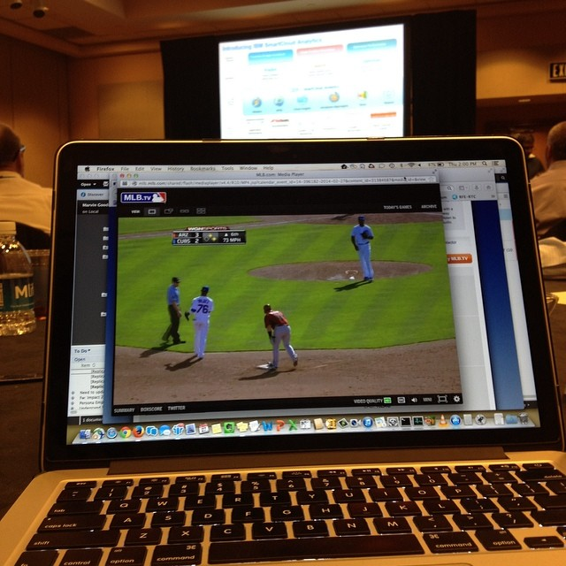
Poor presentations
Notes:
When the presentation becomes uninteresting what do you do?
Here is a real shot from an audience member. This presentation has gone bad. How bad? He is watching a minor league baseball game, in the pre-season bad!!

Slide 4
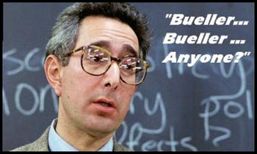





Notes:
Ask: “What have you seen presenters do that ruins it for you?”
Let the audience respond

Slide 5

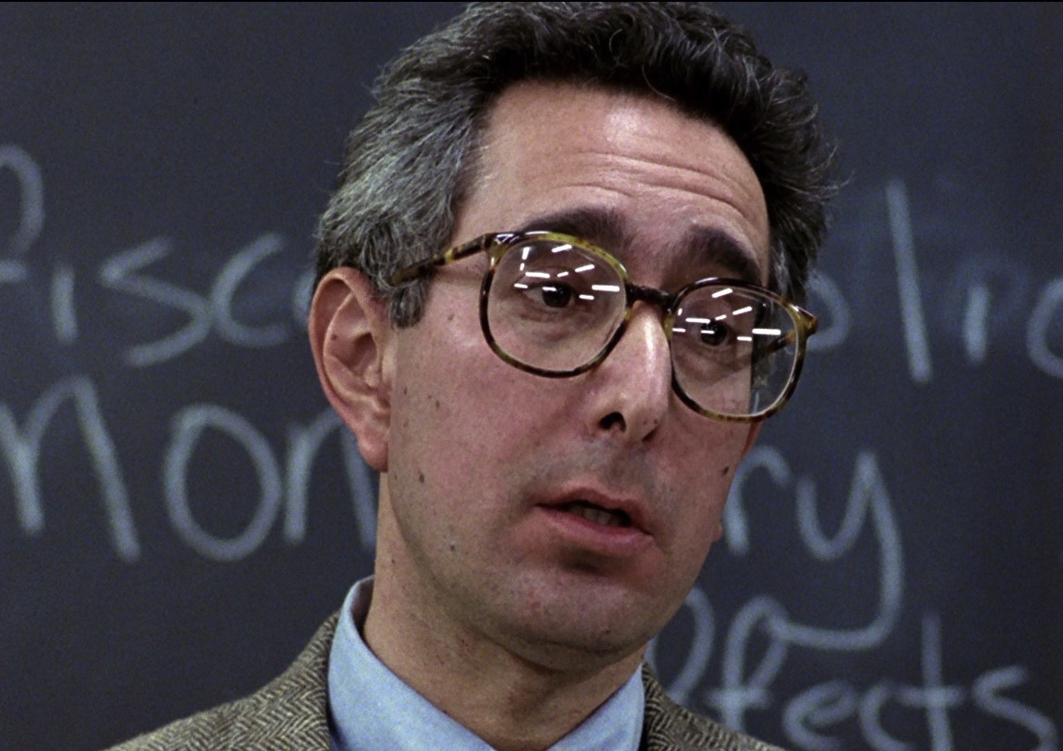
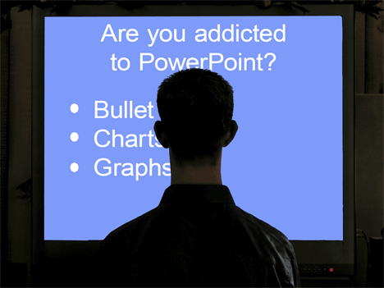
Three Presentation Killers
Unprepared
Disengaged
Poor visuals
Notes:
Thousands of people around the world have taken this course and given their input. Here are the top 3 presentation killers:
1) When the speaker is Unprepared
2) When the speaker seems Disengaged
3) When the speaker uses Poor visuals (lots of text and just reads slides!)

Slide 6
Presentation Killer #1
Unprepared
Notes:
How do you know a presenter is unprepared during their delivery?
Class response
(Advance to next slide for answers)

Slide 7
Nervous
No Structure
Time Management
Off Topic
No Action
Reading Slides
Unknowledgeable
No Flow
Notes:
“Have you ever done any of these presentation killers before as a presenter?”
Any one of these can cause an audience to disengage. Doing multiples of these is a communication nightmare!
We have all fallen short at one time or another. We fall into these traps because our preparation paradigm is skewed. So how do we prepare effectively to overcome these attention killers that rob us of effective communication?

Slide 8
Know your purpose
& Structure the body
Chapters Two and Six:
Notes:
Two tried and true methods to overcome unpreparedness:
Know your purpose
Have structure to the body of the presentation
These two methods are found in the book Corporate Ovations by Kevin Karschnik and Russ Peterson Jr.

Slide 9
Purpose?
Notes:
Alice in wonderland. We all know the story of a young girl who gets lost in the rabbits den. She has no idea where she is or where to go. She stumbles onto a wild tea party, meets the mad-hatter and others. Finally she runs into a character sitting in a tree. Who is it? It is the Cheshire Cat. She asks the cat “Excuse me, can you tell me where I aught to go from here?” The cat responds “That depends on where you want to get to” Her reply? “I don’t really much care where” to which the cat says “then it really doesn’t matter which way you go.” Where does she end up? In front of the Queen who says “Off with their heads!” Not where we want to be.
As a presenter, if we do not know where we are going, how will we know we have arrived? Or that the audience has arrived? Many sales people state they over-sell. I wonder if this is because they do not have a well defined destination and then mistakenly go right past it, when they should stop and celebrate.
Before you create a PPT deck or even a single slide, or even research your topic, know where you want to end up and where you want the audience to end up. Knowing this path you and your audience must take will make preparation more focused and keep you on track so you don’t end up in some proverbial rabbit hole… lost!
Purpose is just this: How much do you want the audience to Know? Feel? Do? with the information?

Slide 10
How much do
they KNOW?
How much do
they CARE?
Notes:
Once we have a clear destination and know where the audience should be at the end of the presentation, we need to understand where they are now. Ever help someone on the phone who was lost? Two questions we ask: “where are you trying to get too?” and “Where are you now?” As presenters we spend too much energy on the first and almost none on the second. How foolish our instructions would be to our lost friend if we gave them the wrong starting point. How foolish indeed.
We need to know: How much they know? And How much they care?
You can: A)put yourself in their position, how would you respond? B) ask someone who knows the group or C) ask them directly.
What we are doing is defining the target then hit it every time. The definition is understand “B” the place we want to arrive at. Then learning “A” the spot we are presently located. Everything we do now in our preparation is to help move the audience from Point A to Point B.

Slide 11
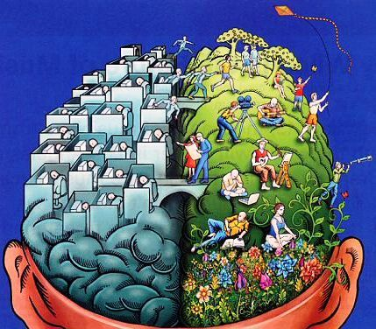
Left Brain vs. Right Brain
Notes:
Science involved with what we have just discussed.
* Right half = creative, emotional
* Left half = analytical, mathematical, logical
We are taking a whole brain approach. We want to inform, inspire, then see implementation. Empirical knowledge will not drive action alone. We all know something we should be doing but are not. Add emotion to it and we have action. Use only emotion without knowledge and you get “buyers remorse.”

Slide 12

Notes:
Use an example of when you were caught off guard with an impromptu presentation.
Russ Peterson Jr. was once invited to attend the kickoff for the CNP Leadership Academy:
*He was invited to observe class members the week before his workshop for them
*To his surprise, he was asked to stand and speak to the group for 10 min about the upcoming workshop
Such situations usually become a “show-up and throw-up” type of presentation. Instead, he used an iSpeak Quick-Start Model to quickly develop a presentation in his mind. The tool is called “What – Why – How”

Slide 13

Future Plans
Opening
What?
Why?
Transition!
How?
Closing
Notes:
Don’t do the ‘data dump’ or the ‘show-up throw-up’ approach. Use structure
What? = issue
Why? = priority, cause/effect, importance
Transition = use a transitional phrase “Here is what we must do” or a transitional question “What do we do?”
How? = solution/overcome. This is where the rubber hits the road

Slide 14
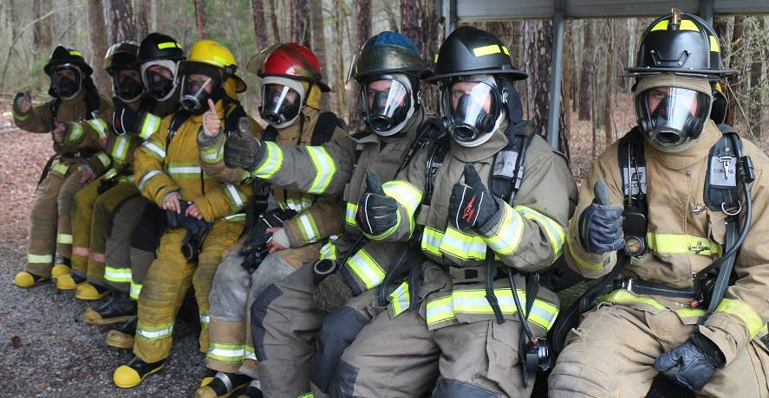
What – Why – How
Notes:
Structure in Sales
Example in this slide: Selling safety equipment

Slide 15

What – Why – How: Sales
WHAT is proposed solution?
WHY this option?
HOW do they purchase?
Notes:
Sales: persuasive, make a decision
Structure here will keep you on topic and not get lost in all your enthusiasm for the sale.

Slide 16

What – Why – How: Leaders
Notes:
Using this structure works well for Leaders
Leaders: create vision, direction, goal

Slide 17
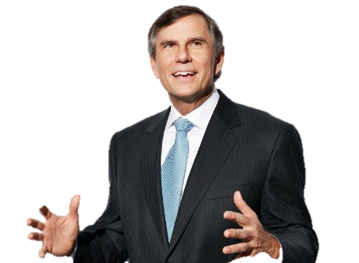
What – Why – How: Leaders
WHAT is the proposed path forward?
WHY did we choose this option?
HOW will we implement it?
Notes:
Structure with Leaders might look like this, applied to a future vision the Executive is casting.

Slide 18
Notes:
Number 2 presentation killer?

Slide 19
Presentation Killer #2
Disengaged
Notes:
Disengagement.
When the speaker does not connect with the audience, the audience will quickly become involved with other topics that are of a higher priority to them. Like their smart phone!
How do you connect with an audience? There are several ways. One of the very best is….

Slide 20
Corporate storytelling
Chapter Seven:
Notes:
Corporate Storytelling.

Slide 21

Notes:
Something about the phrase that brings out the inner child in us all…
Not suggesting this line as a good one for corporate storytelling!! But stories work.
Bill Cosby doesn’t tell jokes – he tells stories!
Not about entertaining, it’s about engaging! Share a story about the subject matter and you can engage your audience.

Slide 22

Methods to connect
Stories
Facts, Statistics
Metaphors
Visuals
Audience Involvement
Notes:
Methods to connect with any audience…
When you can use more than one. Using just facts is a data dump.
Bring richness to your presentation by giving the audience something they can connect with, like a story.

Slide 23
What does your
Audience
want?
Notes:
Here is the key and it ties back to your Purpose!
Does everyone like a story? Yes
Does everyone want a story? hmm

Slide 24

Notes:
You are speaking on leadership
*decide to use a fishing story as an example of characteristics of leadership
Transition: Now let’s think about whether or not all audiences would want to hear this story…

Slide 25
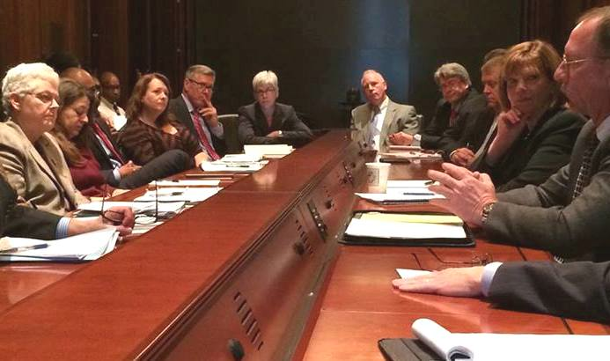
Notes:
Does this group want to hear it? Probably not.
What do they want from this meeting and your presentation? Get to the point.

Slide 26

Notes:
Take the same group on a leadership retreat where fishing may be an activity.
*do they want to hear a story about how fishing relates to characteristics of good leadership? Yes
“Some like stories, some don’t” is false. Depends on What / How / When / Audience / the situation.

Slide 27

Where do I start?
Notes:
Where to start?
Know the audience
know the story

Slide 28

Notes:
Where to start? What does the audience know and how much do they care. Start there.
What’s the point of the story? Persuasion? Informative? To set a tone of urgency?
Where do you want the presentation to take the audience? How does the story help you get the audience there?
A ----> B
A = Begin or where your audience is at present
B = Destination, purpose

Slide 29


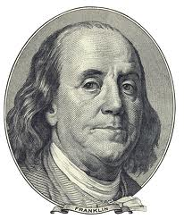

Stories
My Story
Other People
Historical
Fiction
Notes:
Types of stories:
Moves up from bottom with the less engaging form of story to the more engaging.
Give examples of each:
Fiction – two caterpillars talking as they see a butterfly
Historical – King Richard defending his kingdom faces a new challenger
Other People – Julie had a very embarrassing moment
My Story – When I was a first year intern, I had a most interesting boss.
(If you have time, share one of your stories. Then, ask the audience which category the story fits under.)

Slide 30

Notes:
How do we structure it? The folks in Hollywood are experts at it.
Characters, Dilemma, Action, Resolution
While we are not creating Hollywood blockbusters here, we can learn from Hollywood and apply to a business setting.
For example, with an engineering or IT example:
Characters: Jignesh and Paul, in our Database support group
Dilemma: The database cluster went down and did not fail over to the redundant system properly. Our customer’s website is now down!
Action: Paul called in Tier 3 engineering support, Managers notified, Sales group notified, contacted hardware department too
Resolution: Paul located another server already racked and wired. Jignesh loaded the database image from a tape backup and had the customer back online within 30 minutes.

Slide 31

Character Names
Use Dialogue
Delivery Timing
Body Language
Notes:
Knowing a story is not telling a story.
Four Tips:
Names – Voice – Timing – Body Language
Names:
*protect the innocent
*Children want to know names of characters. (e.g. A little girl had a garden..(What’s her name?))
Dialogue:
*Don’t be a boring reporter. Add richness to the story by making the characters and their dialogue come to life.
*My boss says he needs me to take the lead on the project vs. My boss, Sarah, says “Bill, I need you to take the lead on the project.”
Timing: 2 minutes or less is usually a good benchmark for business stories in a professional setting.
Body Language: Use gestures and positions in the room to help the audience envision what is happening in story. Stay congruent, don’t just wander or stay glued in one spot trying to disappear.

Slide 32
Notes:
With good preparation, clear direction along with a great story to help engage, what more can I do?

Slide 33
Presentation Killer #3
Visual Aids
Notes:
Avoid Presentation Killer #3… poor visual aids, lots of text, and reading from the slides with your back turned!

Slide 34
Using visual Aids
Chapter Ten:
Notes:
Visuals greatly improve persuasion, understanding, and retention when used correctly.
How many have seen slides full of text?
How many want to see a slide full of text?
100% of us have seen it, and 100% don’t want too.

Slide 35
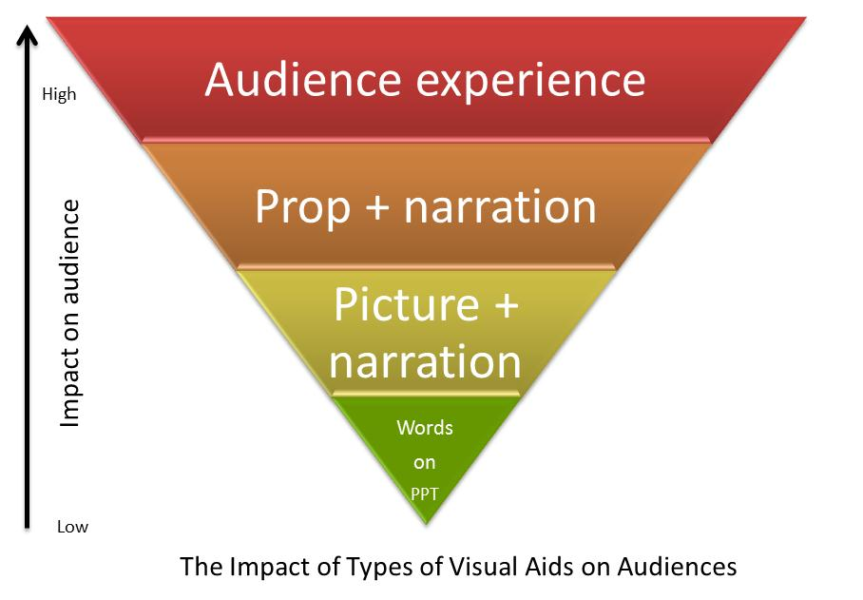
Notes:
Impact on audience increases as visuals move away from Words on PPT to an Audience Experience. Like I just did with you by asking you a question and having you raise your hands in response!
The following slides are visual examples of this movement and impact.
(With each example, help the group see how they might improve the slides they use.)

Slide 36

How Much Caffeine is in Coffee, Tea, & Cola?
Coffee, tea and chocolate all naturally contain varying amounts of caffeine, while colas have different amounts of caffeine added to them. The list below outlines how much caffeine is in each of these drinks, including decaf coffee / tea, low-caffeine drinks and caffeine-free teas.
Brewed Coffee: 95 mg
Instant Coffee: 82 mg
Red Bull: 80 mg
Pepsi Max: 69 mg
Black Tea: 45 mg
Coca Cola Classic: 40 mg
Espresso, Single Shot: 27 mg
Green Tea: 20 mg
Hot Chocolate: 19 mg
Decaf Coffee: 3 mg
7-Up / Sprite: 0 mg
Notes:
Too much text
Hard to determine levels of caffeine because it is listed in text form only

Slide 37
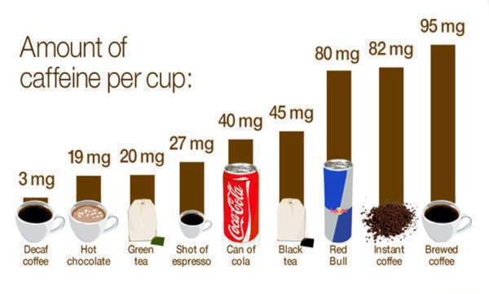
Notes:
Pictures and bar chart make it much easier to interpret the data.

Slide 38
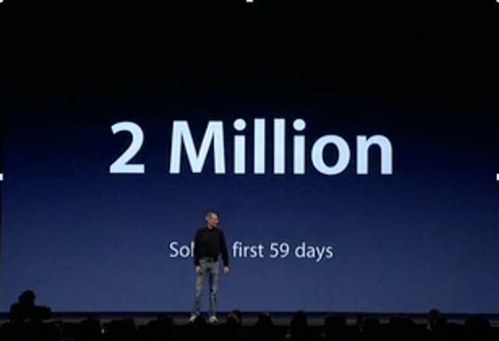
Notes:
Slides can be very simple and yet have huge impact on audience and their retention.
Steve Jobs was well known for taking the normal and making it unusual. “Text on a slide” sounds horrible… until Steve interpreted to mean something like this! Text on a slide can be impactful, if it is simple.
General rule of thumb is that the audience needs to be able to interpret the meaning (purpose and point) of the slide in 3 seconds.

Slide 39
Safety Products – Customer Support
Respiratory Protection
Gas and Flame Detection
Thermal Imaging
Communications and Accountability
Compressors
Notes:
Text only can be simple… but still boring in a bulleted list.

Slide 40


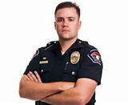

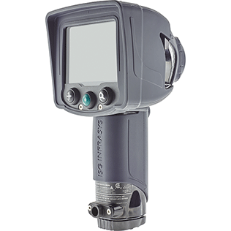

Safety Product Support
Notes:
What about the same topics, but in a visual format?

Slide 41
Notes:
So what are some next steps for you?

Slide 42
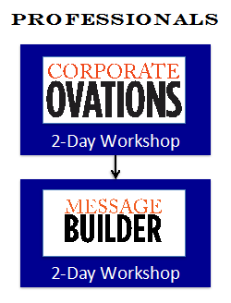
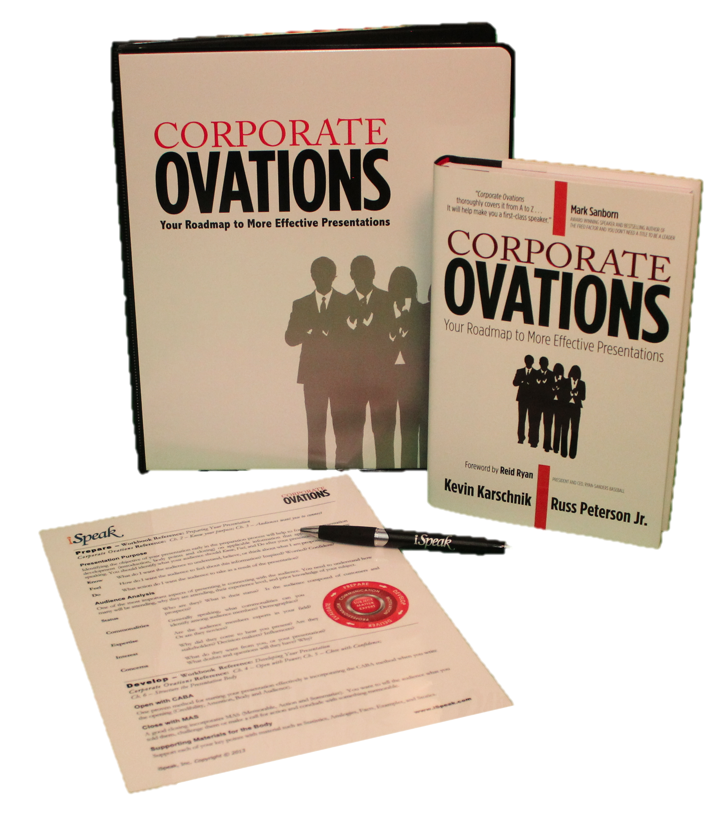
Notes:
We offer the two-day Corporate Ovations workshop here at company name.
You can register at (provide the location for them to register.)
Transition: If you don’t have time now for the workshop, how else can you get more information?

Slide 43






Notes:
You can get a copy of the Corporate Ovations book on Amazon.
(Or we have copies in our corporate library available for you.)
The authors/creators of Corporate Ovations are Russ Peterson Jr. and Kevin Karschnik. They developed and taught the Corporate Ovations workshop to Fortune 500 companies around the world to thousands of students. After almost ten years, they decided to document their methodology in the book. It was released in May of 2013.

Slide 44
Three Presentation Killers
Unprepared
Disengaged
Poor visuals
Notes:
Our top three presentation killers

Slide 45
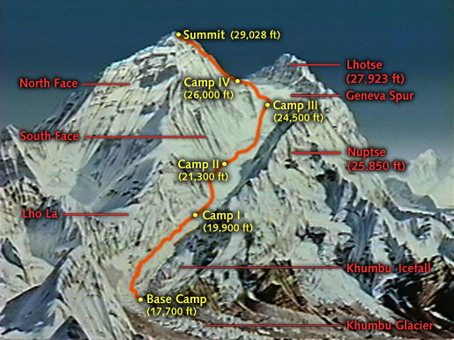

Notes:
Slide builds:
Mount Everest:
* 1921 first expedition
*1953 first person to reach the top. Edmond Hillary made it to the summit. England so impressed made him a ‘Sir.’
* Today – since 1953 over 5000 times the summit has been reached.
Leaders Know the Way, Go the Way, Show the Way – John C. Maxwell
Let’s all commit to being leaders in our area by not only being subject matter experts, or taking care of the projects and issues…
But let’s commit to being leaders by showing others the way and doing that through effective communication and presentations.

Slide 46


Notes:
Thank you!

